Slide 1
Community link worker service TABA

Slide 2
What does a Community Link Worker do?
Works with patients to identify social factors that may be affecting their health and wellbeing.
Uses a holistic and asset based approach to empower patients to make positive changes and reduce health inequalities.
Addresses barriers to engagement to enable people to play an active part in their care.
Utilises and builds on the local community assets.
Aims to increase patients control over their own health and lives.

Slide 3
Evidence Base
The evidence suggests social prescribing can reduce the burden on primary and secondary care (Polley et al, 2017)
Key findings:
Reduction in demand for GP services (Kimberlee et al, 2014; Longwill, 2014)
Reduction in A&E attendances (Farenden et al, 2015)
Reduction in secondary care referrals (Brandling et al, 2011)
The NHS Long-Term Plan have set a target that by 2023/24 every GP practice in England will have access to a social prescribing link worker
Notes:
TABA are in the fortunate position that every practice has had access to a link worker since 2015.
Wigan has been a national lead with social prescribing.

Slide 4
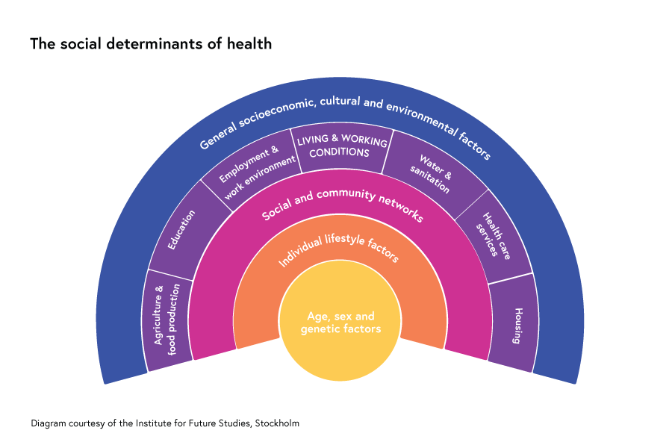
Social Determinants of health
Notes:
Many factors combine to affect the health of individuals in our communities. Whether people are healthy or not, is determined by their circumstances and environment. Factors such as where we live, the state of our environment, genetics, our income and education level, and our relationships with friends and family all have considerable impacts on health.
The image above provides examples of the social determinants of health, which can influence health equity in positive and negative ways:
“Research shows that the social determinants can be more important than health care or lifestyle choices in influencing health. For example, numerous studies suggest that SDH account for between 30-55% of health outcomes”. https://www.who.int/health-topics/social-determinants-of-health
By addressing these social determinants we can improve health and reduce longstanding inequities.

Slide 5
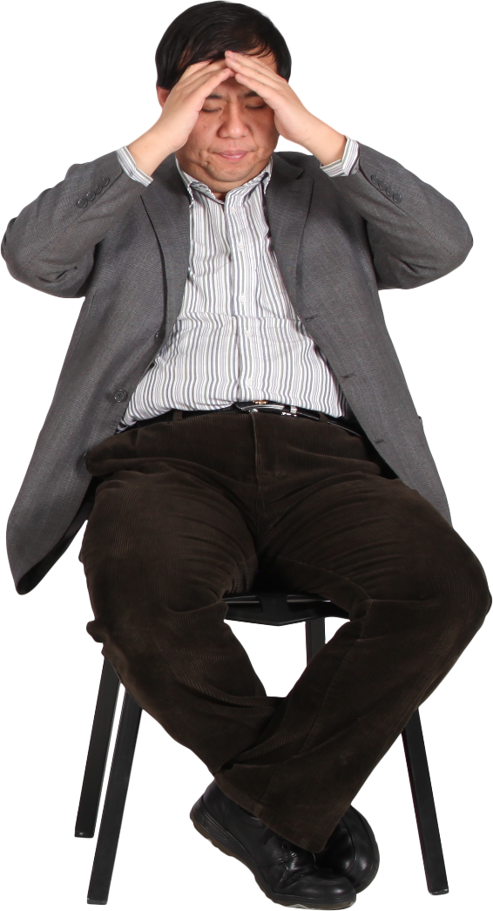
Client scenario
Meet Joe
Joe is 54 years old
Lives alone
Unemployed due to ill health
Benefit generated income
Is overweight, eats unhealthily and smokes
Regularly attends GP surgery with mental health issues and chest infections
Is feeling very low due to his mental and physical health
The GP notices that Joe regularly attends the surgery for the same problems.
The GP asks Joe if he would like support with his health and wellbeing.
Joe agrees that it is time to make changes and consents to a referral.

Slide 6
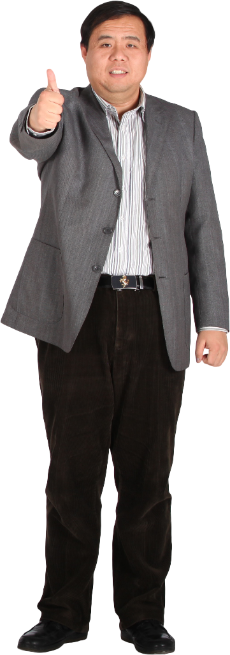
Client scenario
The community link worker offers appointments 60-90 minutes long, this gives Joe plenty of time to discuss his problems.
Joe and the CLW:
Work through wellbeing tools and create a wellbeing plan that Joe can do when he is starting to feel low, this helps Joe to feel more in control of his mental health and less dependant on the GP.
Look at community groups and hobbies that Joe is interested in so that he can build a social network and reduce his social isolation.
Complete a benefits check and refer Joe into Awarm for help with heating his home, living in a warm home will reduce the number of chest infections that Joe gets and his reliance on the GP and medication.
Work with the Healthy Routes advisor within the practice for support with his lifestyle factors and becoming healthier and happier.
During the appointment Joe discusses:
He often feels low and doesn’t know what else to do other than see the GP.
He feels socially isolated.
His income is very low and he cannot pay bills or heat his home.
Would like to eat healthier, become more active and stop smoking.
Joe feels more resilient and has learned that he can make changes to control his own mental and physical health, he continues to work with the CLW become a healthier and happier version of himself.

Slide 7
How it looks now
“I had been referred to the community link worker service a few times by my GP and had spoken to Chloe but I could never go through with the appointments at the GP surgery. I would not have accepted the support without the appointments being over the phone, I was too anxious and nervous talking about things face to face.”
Offering more than one appointment type has seen our DNA rate drop to 2%. This means we are engaging with and helping more residents than ever before.
CLW’s can offer support:
Face to face
Over the telephone
Video calling
Virtual tea and chat group
Walking appointments
Appointments in the community
Home visits

Slide 8
You should refer someone if…
They are:
Socially isolated, bored or lonely and would benefit from being part of the community.
A carer for someone and may benefit from some support.
Struggling with debt, finances or have benefit queries.
Unemployed and would like support to find work.
Have experienced a bereavement and may need some support.
Are experiencing problems with their family.
Are suffering with their mental wellbeing.
Have retired and are struggling with the change in circumstances which can lead to further problems.
Suffer from long term conditions and may benefit from support in the community.
Are interested in volunteering.
Are homeless or about to become homeless.
Disclose that they have no money/food and don’t know where to get help.
You feel they would benefit from help with any other social problems.

Slide 9
How to refer
Professional referral
Completed referral form to be emailed to:
Wigan.clw@nhs.net
Self-referral
Telephone: 01942 836967
18+ or families

Slide 10
Thank you
Do you have any questions?

